Slide 1



Lexical Analysis: Understanding the Building Blocks of Code
Welcome to our presentation on lexical analysis. This critical step in the compiler process breaks down code into meaningful units called tokens. Understanding lexical analysis is essential for programmers, compiler designers, and anyone interested in the inner workings of computer languages.
sB
by swaroop B
Skm
by manohar
Guided by
DR.G.Michael

Slide 2
Introduction to Lexical Analysis
Foundation of Compilers
Focus on Tokens
Lexical analysis is the first phase in a compiler's pipeline. It acts as the bridge between raw code and the compiler's understanding of it.
The primary goal is to break down the source code into smaller, meaningful units known as tokens. Think of them as the individual words of a language.

Slide 3
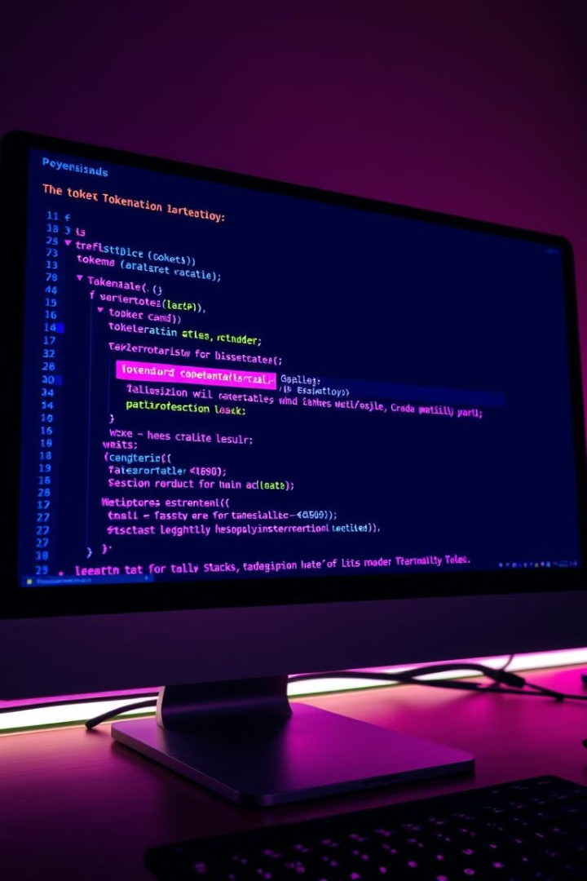
Objectives of Lexical Analysis
1
Token Identification
2
Token Classification
Recognizing the individual tokens from the input stream, distinguishing keywords, identifiers, operators, and constants.
Assigning each token a specific category based on its role and meaning within the programming language.
3
Error Detection
4
Token Stream Creation
Detecting invalid characters, unexpected sequences, and syntax errors during the process of scanning the code.
Producing a stream of tokens that represent the input code in a structured and organized manner.

Slide 4
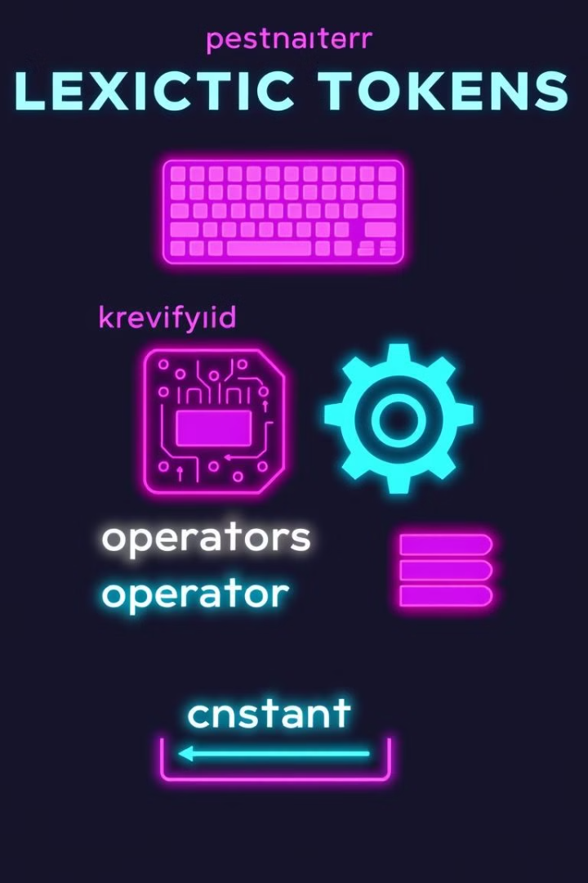
Lexical Tokens and their Classification
Keywords
Identifiers
Reserved words with predefined meanings, like "int," "if," and "while," which are essential for programming logic.
User-defined names used for variables, functions, and other program elements, like "myVariable" or "calculateSum."
Operators
Constants
Symbols that perform operations, like "+", "-", "*", "/", "=", and "<", indicating calculations, comparisons, or assignments.
Fixed values that represent specific data, like "10", "3.14", or "true", representing numerical or logical values.

Slide 5
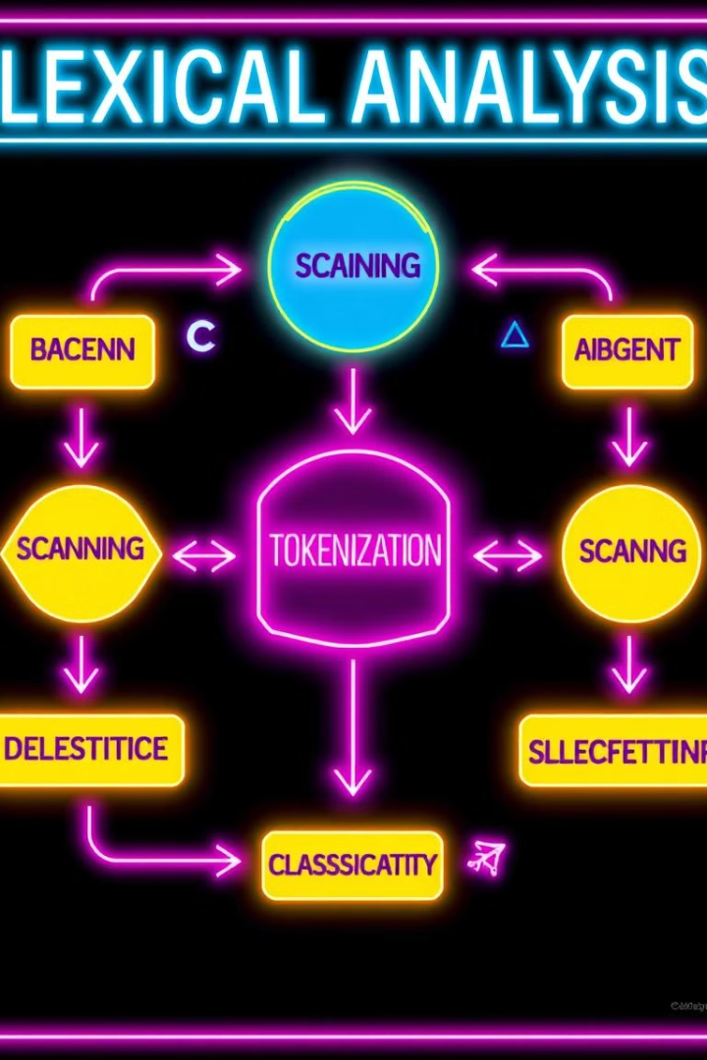



Techniques for Lexical Analysis
Regular Expressions
Powerful patterns that describe the structure and characteristics of tokens, often used for flexible and efficient pattern matching.
Finite Automata
Mathematical models that simulate the recognition of tokens by transitioning between states based on input characters, providing a structured approach to lexical analysis.
Lexical Scanners
Software components that implement the logic of lexical analysis, transforming source code into a stream of tokens for further processing.

Slide 6

Finite Automata and Regular Expressions
1
Regular Expressions
Patterns representing the structure of tokens, using symbols like "." (any character), "*" (zero or more repetitions), and "+" (one or more repetitions).
2
Finite Automata
Mathematical models that represent a finite number of states and transitions, used to recognize tokens defined by regular expressions.
3
Lexical Scanner Implementation
Implementing the finite automata using code, allowing the scanner to effectively identify and classify tokens based on the predefined rules.

Slide 7





Implementation of Lexical Analyzer
Choice of Language
Selecting a programming language suitable for the task, considering factors like performance, syntax, and libraries for lexical analysis.
Defining Token Types
Defining the specific categories of tokens, like keywords, identifiers, operators, and constants, based on the target programming language.
Building the Scanner
Implementing the logic of the lexical analyzer, using regular expressions, finite automata, or other techniques to identify tokens.
Testing and Validation
Thoroughly testing the lexical analyzer with various input code samples to ensure accuracy and robustness.

Slide 8



Challenges and Limitations of Lexical Analysis
Ambiguity
1
Addressing cases where tokens can be interpreted in multiple ways, leading to potential errors in analysis.
Contextual Dependence
2
Handling situations where the meaning of a token depends on the surrounding context within the code.
Error Handling
3
Developing strategies to handle invalid input, syntax errors, and unexpected characters during the lexical analysis phase.

Slide 9
Best Practices for Efficient Lexical Analysis
Clear Token Definitions
1
Precisely define the syntax of each token type using regular expressions or other formal methods.
Optimization Techniques
2
Employing techniques like lookahead, caching, and efficient data structures to optimize the scanning process.
Error Reporting
3
Providing clear and informative error messages to help programmers understand and fix problems quickly.

Slide 10
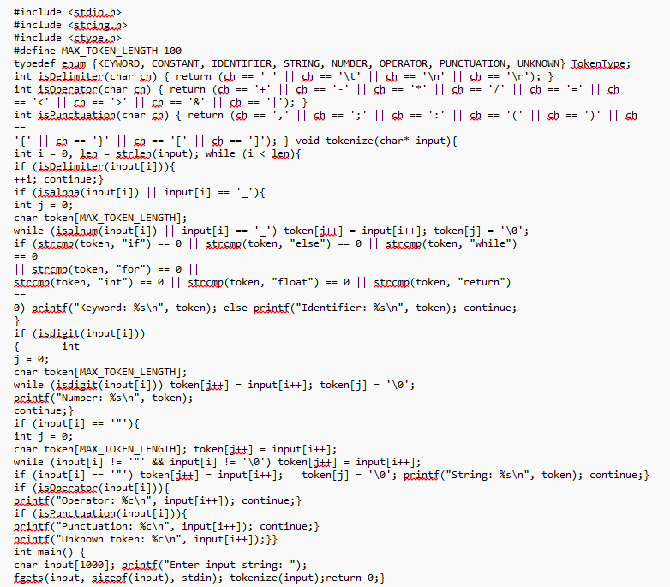
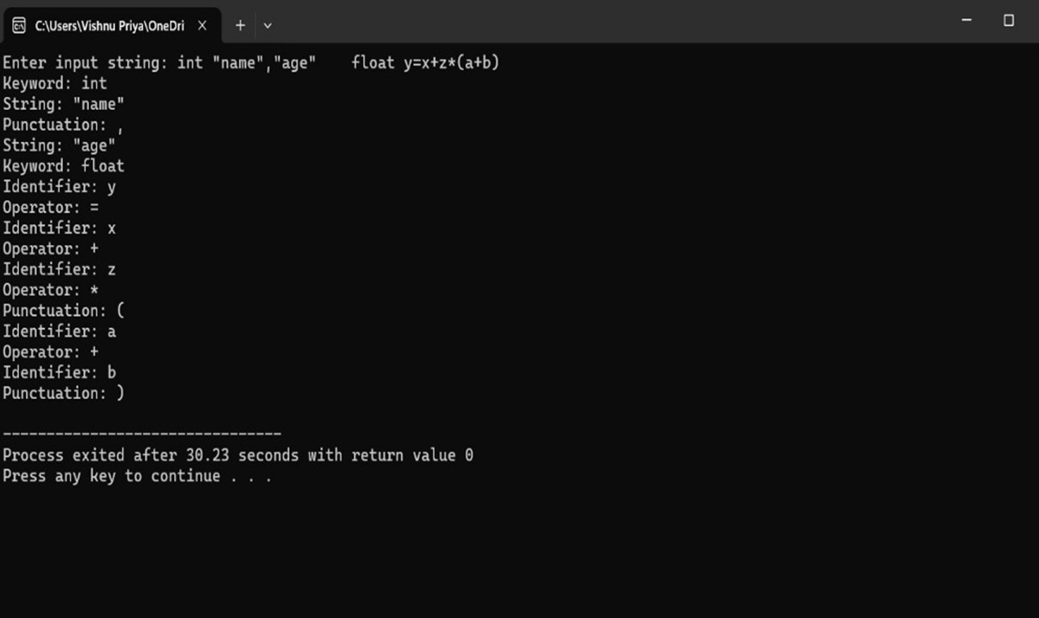
OUTPUT

Slide 11
Conclusion
Lexical analysis is a crucial first step in the compilation process, breaking down code into its fundamental building blocks.
Robust lexical analyzers must handle a variety of challenges, including ambiguity, contextual dependence, and error handling.
Best practices like clear token definitions, optimization techniques, and effective error reporting are key to creating efficient and reliable lexical analyzers.
Real-world applications like compilers, interpreters, and web browsers all rely on sophisticated lexical analysis to function properly.
Continued advancements in lexical analysis will be essential as programming languages and code complexity continue to evolve.

Slide 12

As we conclude our presentation, we'd like to express our sincere gratitude for your time and attention.

